Slide 1
IST718 Apache Spark
Willard Williamson
Adjunct Professor
iSchool, Syracuse University
linkedin.com/in/ncc-1701-d

Slide 2
Attendance
Please fill out the attendance sheet: https://docs.google.com/spreadsheets/d/1G5tiqXQn9mwyubWdINtPI_QONXH1_2U8oYikksgWlss/edit?usp=sharing
Write in a ‘1’ if you are present

Slide 3
Objectives
Describe Apache Spark
List Spark components and their functionalities
Explore Resilient Distributed Datasets (RDD)
Describe the Spark MLlib
Perform Spark Operations

Slide 4
Hadoop
Traditionally:
Hadoop uses single programming model: MapReduce
It only works with data on hard drives
I.O.
Map
Reduce
I.O.
Map
Reduce
I.O.
I.O.

Slide 5
Spark
RAM bandwidth has been increasing exponentially
Spark can perform in-memory computations

Slide 6
What is Spark?
Apache Spark: Apache Spark is a unified computing engine and a set of libraries for parallel data (Spark the Definitive Guide Page 3).
Spark has several high-level tools, including:
ML: a machine learning library
Spark Streaming: enables high-throughput, fault-tolerant stream processing of live data streams
Spark SQL: runs SQL and HiveQL queries
GraphX: an API for graphs and graph-parallel computation
Spark can be executed in two ways:
Standalone
With a cluster manager such as YARN

Slide 7
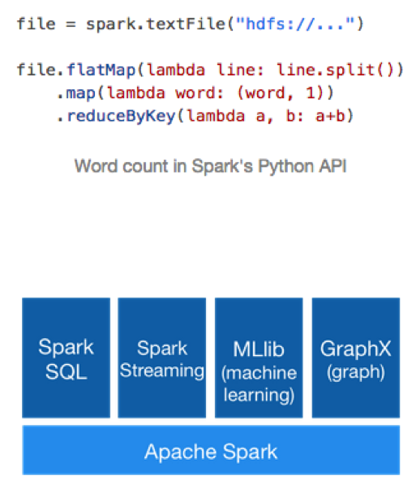
Spark
“Apache Spark™ is a fast and general purpose engine for large-scale data processing.”

Slide 8
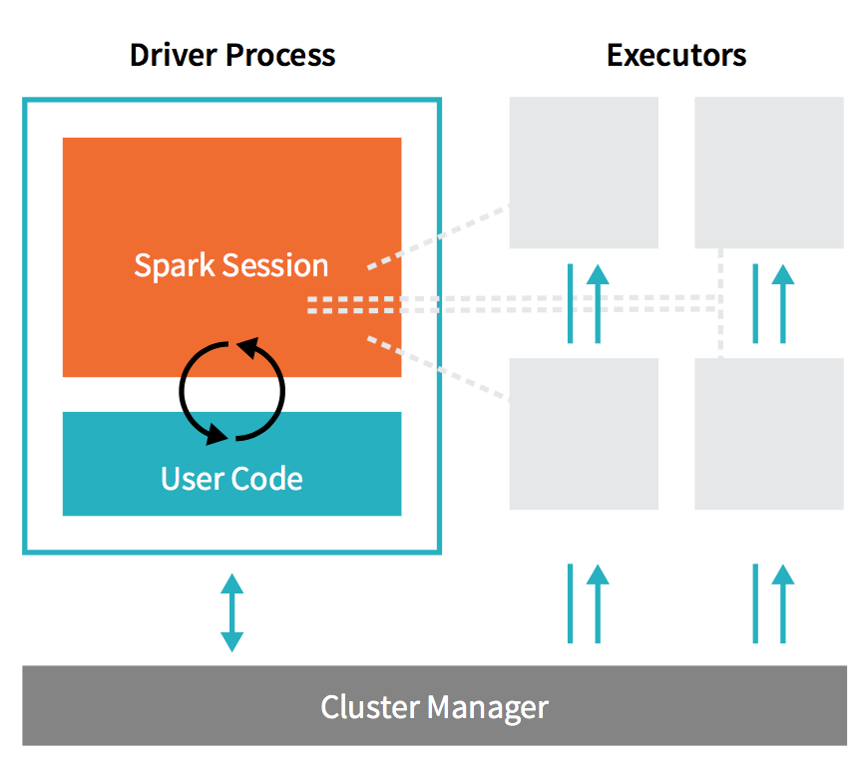
Spark Architectural Components
Spark applications consist of a driver process and a set of executor processes.
Driver and executors can be on one computer or on distributed computers.
Cluster Manager can be YARN or some other manager
This section uses information from Spark the Definitive Guide

Slide 9
Spark Driver Process
The driver process runs the application’s “main” program
Runs on one of the nodes in the cluster (in cluster mode) or on the client computer (client mode)
Is responsible for three things:
Maintaining information about the Spark applications
Responding to a user’s program or input
Analyzing, distributing, and scheduling work across the executors

Slide 10
Spark Executor Process
Responsible for carrying out the work that the driver assigns to them.
Each executor is responsible for two things:
Executing code assigned to it by the driver
Reporting the state of the computation on that executor back to the driver node

Slide 11
Cluster Managers
Controls the physical machines
Allocates resources to Spark applications
Cluster Managers:
Local
Standalone
YARN
Mesos

Slide 12
Cluster Managers
Spark Standalone:
Spark’s internal resource manager which is included in the spark software distribution
YARN: Yet Another Resource Negotiator
General purpose distributed resource manager
YARN is the primary Hadoop resource manager
Not capable of managing an entire data center
Mesos:
Like YARN, a general purpose manager
Uses a different design philosophy than YARN
Can manage an entire data center

Slide 13
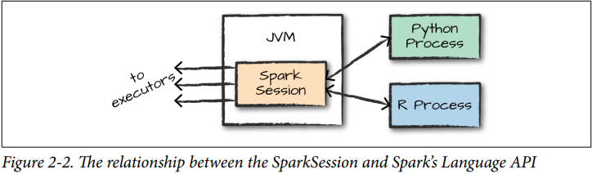
Spark Session and User Processes
Your python code is located in the “Python Process” which is a python interpreter
The spark context in your python code is an interface to the spark session (usually the “sc” variable).
The spark session is running in a Java Runtime Environment
The python interpreter and the spark session JVM are totally separate memory spaces
When you run spark commands, you are using the spark context interface to communicate with the spark session.
Interfaces are available for multiple languages
See Spark the Definitive Guide page 16

Slide 14
Spark 1.6+ vs 2.0+
Spark 1.6+ relied on transformations on arbitrary datasets known as Resilient Distributed Datasets (RDDs)
Spark 2.0+ defines more structure in the form of DataFrames, which are similar to tables in SQL, R data frames, and Python Pandas
Newer versions of Spark define DataSets which are statically-typed DataFrames (more structure)
With more flexiblity comes greater power but less performance
Future Spark machine learning will work with DataFrames and not RDD.

Slide 15
Classic Spark v. <2.0

Slide 16
Spark RDDs
An RDD (resilient distributed dataset) is a fault-tolerant collection of elements on which operations can be performed in parallel.
An RDD is an immutable collection that represents:
A dataset…
…broken up into a list of partitions
A list of dependencies on other RDDs
An optional list of preferred block locations for an HDFS file
Read-only

Slide 17
Important RDD Concepts
Lineage
Information about how an RDD is derived from other datasets or other RDDs
RDD is not necessarily materialized all the time due to lazy execution
Lineage captured on disk as “lineage graph”
Persistence
Indicate which RDDs the computer needs to keep in memory for reuse
User can call “persist” method
Partitioning
RDD elements can be partitioned across machines based on a key in each record

Slide 18
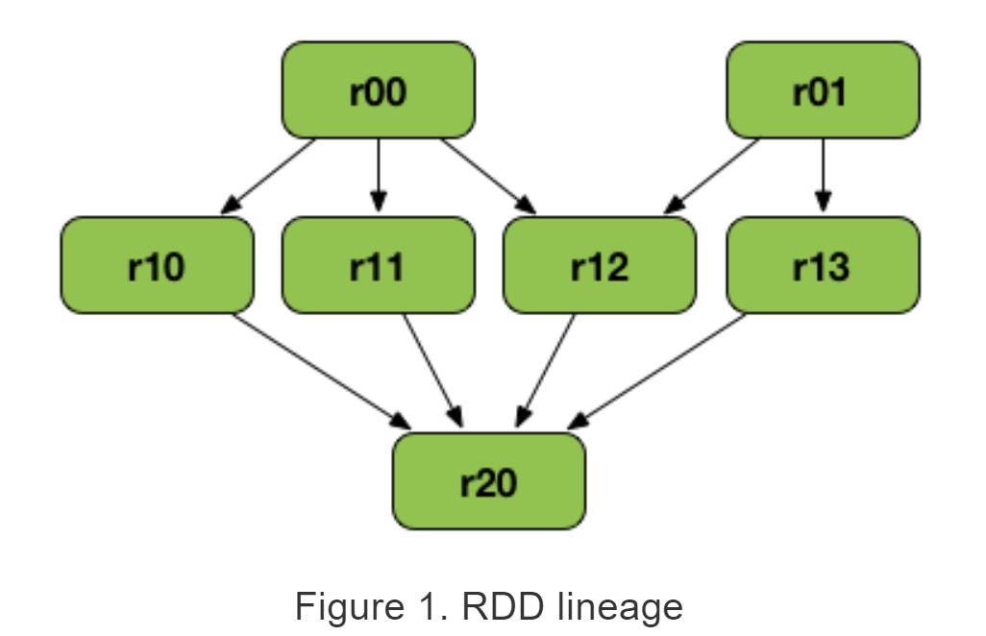
Sample RDD Lineage Graph
r20 depends on many other RDDs
See: https://github.com/ajnsit/mastering-apache-spark-book/blob/master/spark-rdd-lineage.adoc

Slide 19
Creating RDDs
Can create an initial RDD by applying a transformation to data on disk
Can create an initial RDD from a code object
Example ways to create an RDD in Spark:
Use the parallelize operation to convert an existing code object into an RDD
Use textFile operation to convert a text file on HDFS into an RDD
Use sequenceFile operation to convert a binary file on HDFS into an RDD

Slide 20
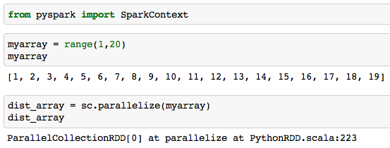
Example: Creating RDDs

Slide 21
RDD Persist
Spark’s persist method
Indicate which RDDs to reuse
Indicate if you want to replicate across machines
Indicate priority of which in-memory data to spill to disk first
Example
logsrdd = sc.textFile(“hdfs://user/mark/logdata”)
fatals = filter(lambda s: s.startswith(‘FATAL’), logsrdd)
fatals.cache()
fatals.count()
# Notes: logsrdd NOT loaded into RAM because of lazy evaluation
# fatals.cache() == logsrdd.persist(storageLevel.MEMORY) tries to persist fatals rdd in memory

Slide 22
RDD Disk and Recover
RDD can spill to disk
Degrade gracefully (to Hadoop mapreduce performance)
Partitions not in use/lesser use and/or low priority spilled first
Failure Recovery
Recovery is facilitated through redundant RDD block copies across cluster computers.
An RDD partition that fails is recovered by the Yarn/Spark Driver
Executer applies lineage to prior RDD (or original data on disk) to recover the RDD.

Slide 23
RDD Checkpointing
Writes an RDD to disk to save the RDD in a specific state
After checkpointing, future references to the RDD don’t need to perform upstream transformations in the lineage.
Similar to caching except that the RDD is stored on disk instead of in memory.
Example:
spark.sparkContext.setCheckpointDir("/some/path/for/checkpointing") words.checkpoint()

Slide 24
RDD Operations
There are two types of operations that can be done on RDDs:
Transformations: create a new dataset/RDD from an existing one
Actions: Trigger a transformation and instructs spark to compute a result from a series of transformations.
Transformations
lazy - they do not compute their results right away
Actions
Instantiates an RDD
See https://spark.apache.org/docs/latest/rdd-programming-guide.html#transformations for a list of transformations and actions.

Slide 25
RDD Dependencies and Transformations
Dependency / transformation used synonymously in Spark the Definitive Guide text book
Two Main Types of Dependencies / Transformation
Narrow – child partition depends on only one parent partition
E.g. map, filter, union
Wide – multiple child partitions depend on one parent partition
E.g. Join with inputs not co-partitioned
Group-by transformations

Slide 26
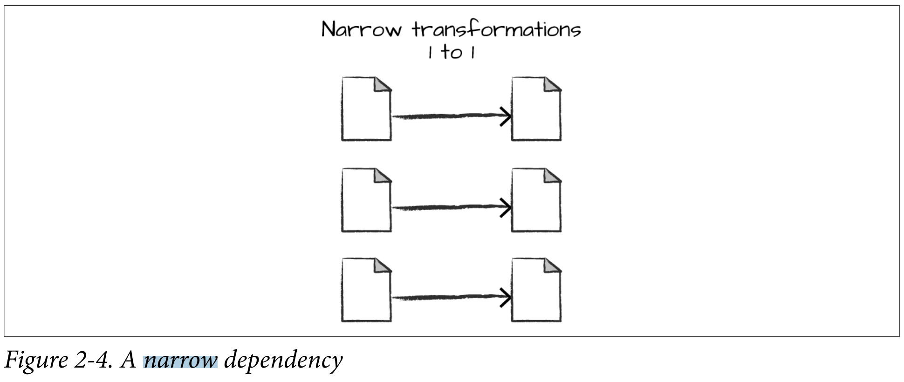
Narrow Transformation / Dependency
Each input partition contributes to one output partition
See Spark the Definitive Guide, Figure 2.4
Also called pipelining, spark tries to perform narrow operations in memory
Example: map

Slide 27
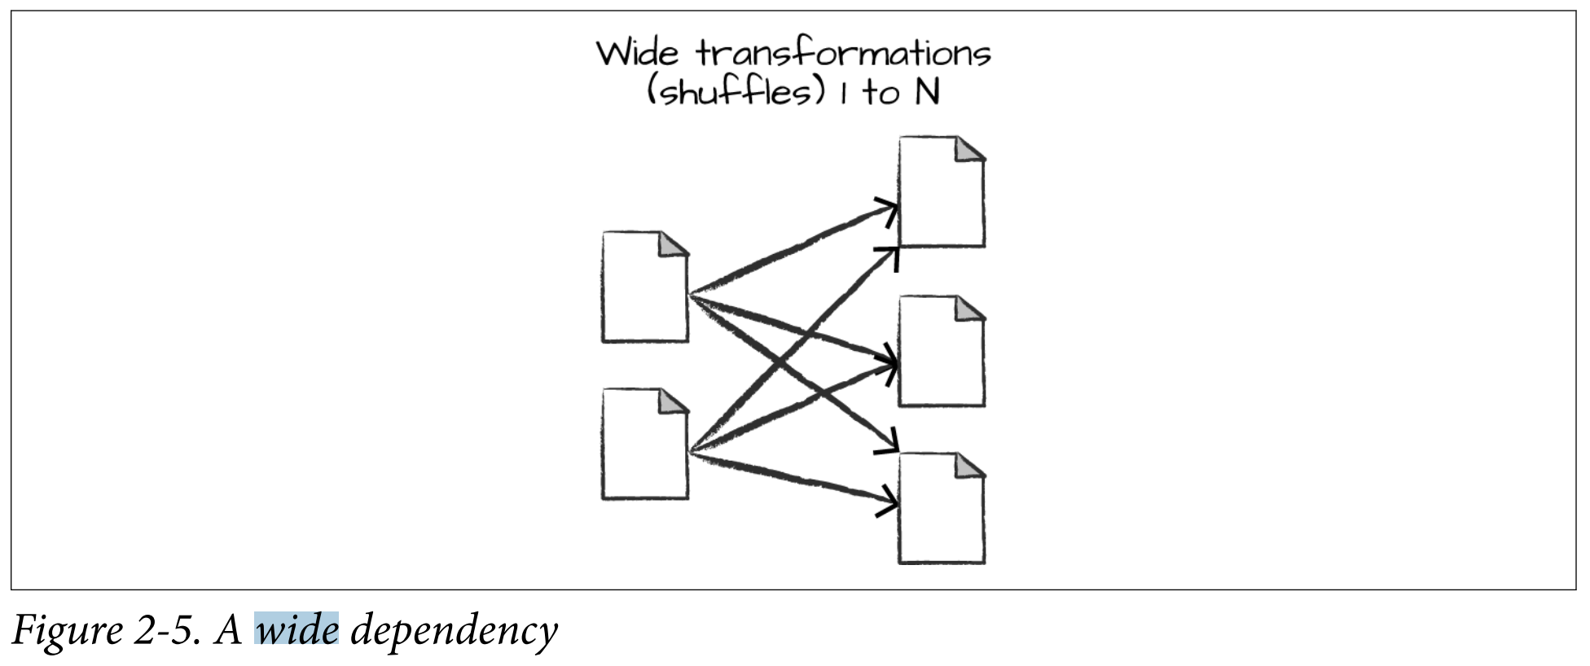
Wide Transformation / Dependency
An input partition contributes to many output partitions
See Spark the Definitive Guide, Figure 2.5
Also called a shuffle where Spark exchanges partitions across the cluster
Example: Reduce by Key

Slide 28
Example Transformations
map(func): returns a new distributed dataset formed by passing each element of the source through the function func.
flatMap(func): same as map but when multiple key-value pairs are returned
filter(func): return a new dataset formed by selecting those elements of the source on which func returns true.
reduceByKey(func): when called on a dataset of (K, V) pairs, returns a dataset of (K, V) pairs where the values for each key are aggregated using the given reduce function func.
sortByKey([ascending],[numTasks]): when called on a dataset of (K, V) pairs where K implements Ordered, returns a dataset of (K, V) pairs sorted by keys in ascending or descending order, as specified in the Boolean ascending argument.
join(otherDataset, [numTasks]): when called on datasets of type (K, V) and (K, W), returns a dataset of (K, (V, W)) pairs with all pairs of elements for each key.
distinct([numTasks]): returns a new dataset that contains the distinct elements of the source dataset.
pipe(command, [envVars]): pipes each partition of the RDD through the provided shell command

Slide 29
Example Actions
reduce(func): Aggregate the elements of the dataset using a function func (which takes two arguments and returns one). The function should be commutative and associative so that it can be computed correctly in parallel.
foreach(func): Runs the function func on each element in the dataset.
count(): returns the number of elements in the dataset.
first(): returns the first element in the dataset.
take(n): returns an array with the first n elements of the dataset.
saveAsTextFile(path): writes the elements in the dataset out to a file in HDFS (or some other file system).
saveAsSequenceFile(path): writes the elements to HDFS in the SequenceFile format.

Slide 30
Operations on key-value pair RDDs
Operations on key-value pair datasets are at the foundation of Hadoop, MapReduce, and Spark 1.6
groupByKey(): group values with the same key, ex. rdd.groupByKey()
mapValues(f): applies function only to values not keys
flatMapValues(f): same as mapValues when function returns several values
keys(): Returns RDD with only the keys
values(): Returns RDD with only the values
Simple operations on RDDs:
union(otherRDD): makes the union of all key-value pairs

Slide 31
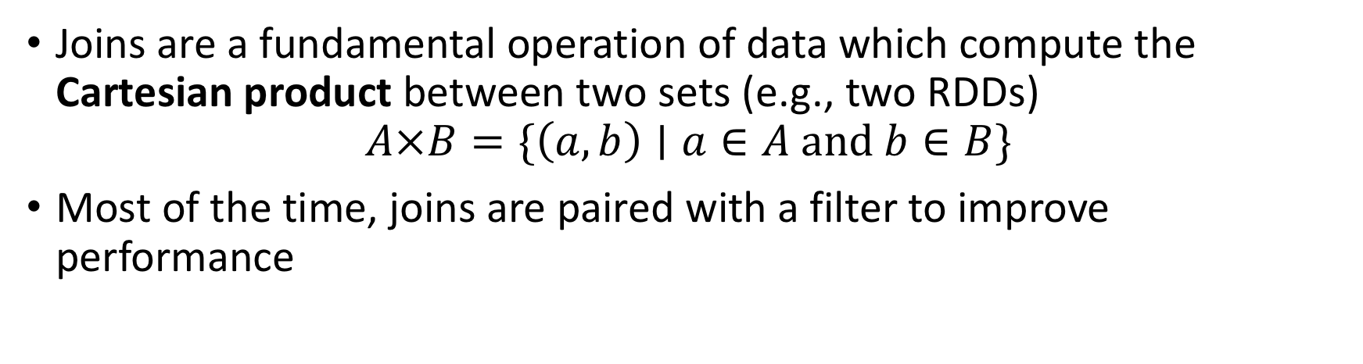
Join operations on pairs of key-value pair RDDs: join operations
Joins are a fundamental operation of data which compute the Cartesian product between two sets (e.g., two RDDs)
$$A×B=\{\left(a,b\right)∣a∈A and b∈B\}$$
Most of the time, joins are paired with a filter to improve performance

Slide 32
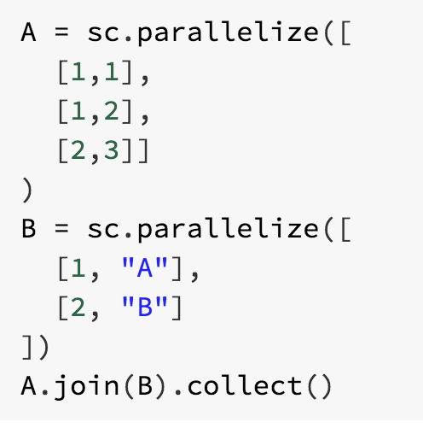

Join operations on pairs of key-value pairs RDDs: join operations
We can use this idea to join key-value pairs and then filter for pairs that have the same key
RDD join performs an “inner join”
Inner Join: Keys must be present in the left and right hand RDD.

Slide 33
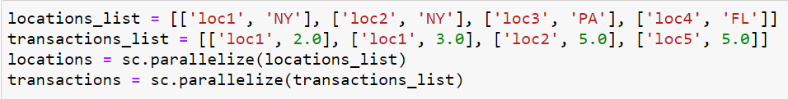
Join operations on pairs of key-value pair RDDs
Lets suppose we want to join RDDs based on state and location ID:
Activity: how can we use join to achieve this?
Explore leftOuterJoin and rightOuterJoin
See class notebook for implementation

Slide 34
Spark 2.0
DataFrames

Slide 35
DataFrames
The problem with RDDs is that they do not have enough structure
DataFrames tries to solve this by adding structure
A DataFrame is a distributed collection of data organized into named columns
Similar to Pandas DataFrames but distributed across the cluster
You access the Spark 2.0+ functionality using the spark object

Slide 36
DataFrames (2)
You can read from multiple sources into dataframes

Slide 37
DataFrames (3)
Parquet files are a preferred data source for Spark data frames
Parquet files are datasets stored in columns

Slide 38
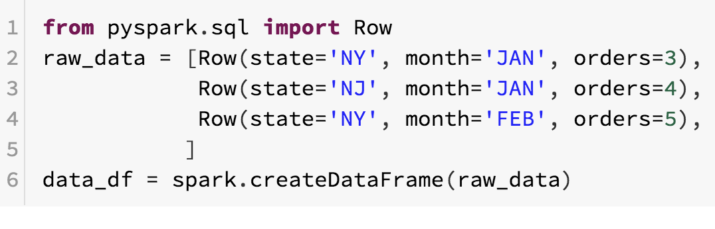
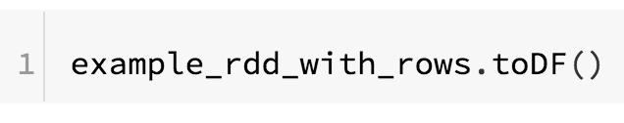
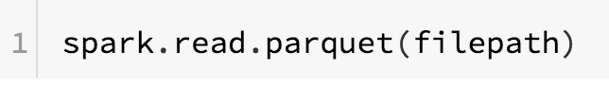
DataFrame operations
Creation of dataframes:
From Row objects:
From RDDs:
From files:

Slide 39
DataFrame operations
All data in a specific column has the same type
DataFrame types can be hierarchical: The type of a column might be another “DataFrame”
You cannot perform dataframe operations using Python
Instead, you transform DataFrames by selecting, modifying, filtering, joining, grouping, or aggregating using specialized Spark commands similar to SQL
Many of these commands are symbolic representations of the operations
After the transformations, Spark builds an execution plan that is optimized for the column types and the operations

Slide 40
Exploring a DataFrame
printSchema(): shows the datatypes of the dataframe
show(): prints the first n rows
take(): return first n rows
sample(withReplacement, fraction): randomly sample rows (approximate)
display(df): Exploratory interface for dataframe

Slide 41
Selecting and modifying a DataFrame
select(*expressions): returns a new DataFrame with columns
withColumn(colName, expression): creates a new column based on the expression
Expressions are symbolic operations
Symbolic operations can hold literal values and placeholders for column names
You can perform symbolic operations on both literals and placeholders
Some symbolic operations are available in pyspark.sql.functions

Slide 42
Examples
Examples on the following slides are implemented in the ‘Introduction to Spark and DataFrames.ipynb” ipython notebook.

Slide 43
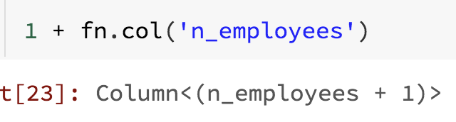
Symbolic operations
expression = 1 + n_employees
To express the previous operation, I need a literal value (1) and a placeholder for the column n_employees
A symbolic operation produces a column object which contains the defined operations

Slide 44
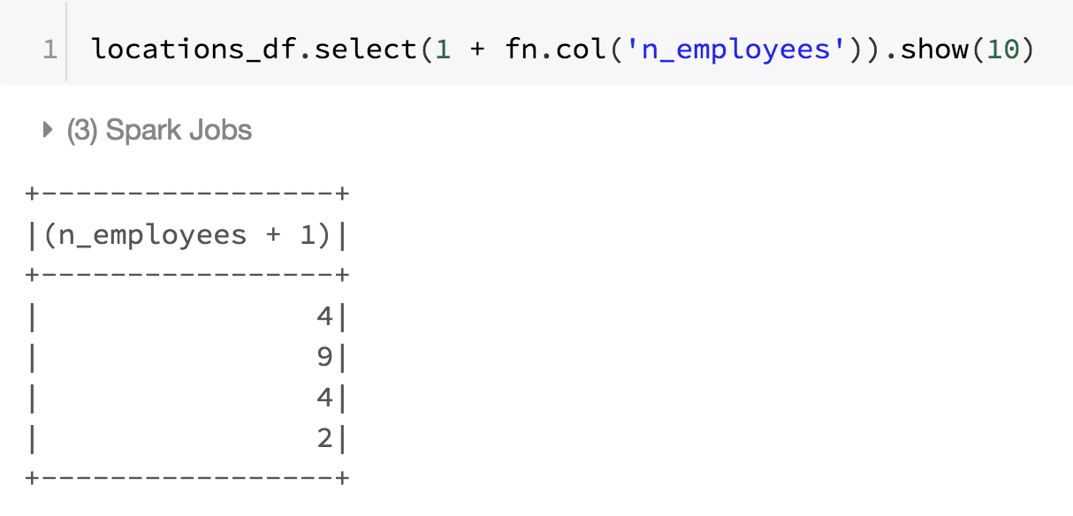
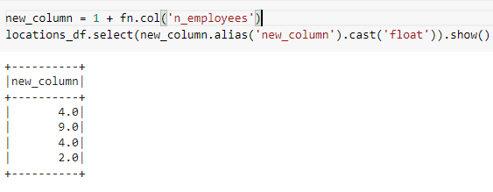
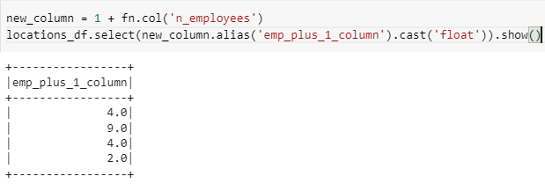
Symbolic operations
Change column type
Change column name

Slide 45
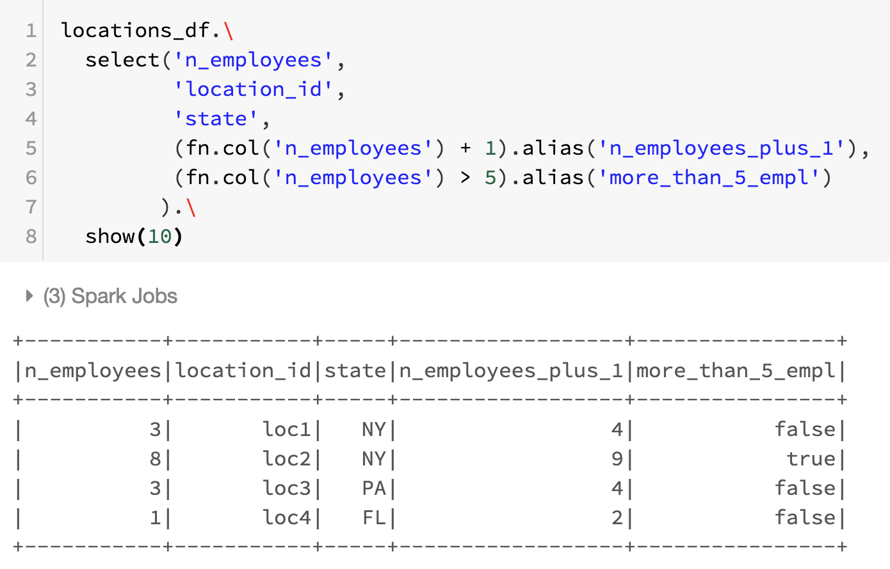
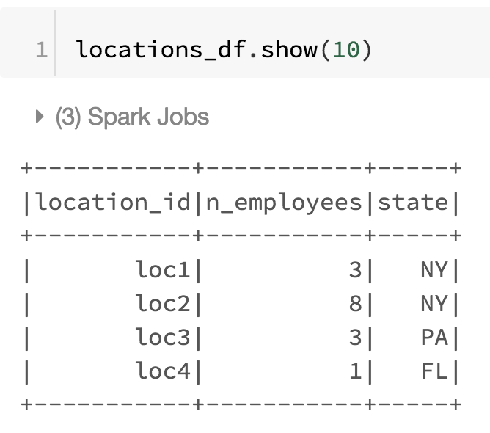
Selecting and modifying (1)
You can use select to select columns, modify them, or create new columns

Slide 46
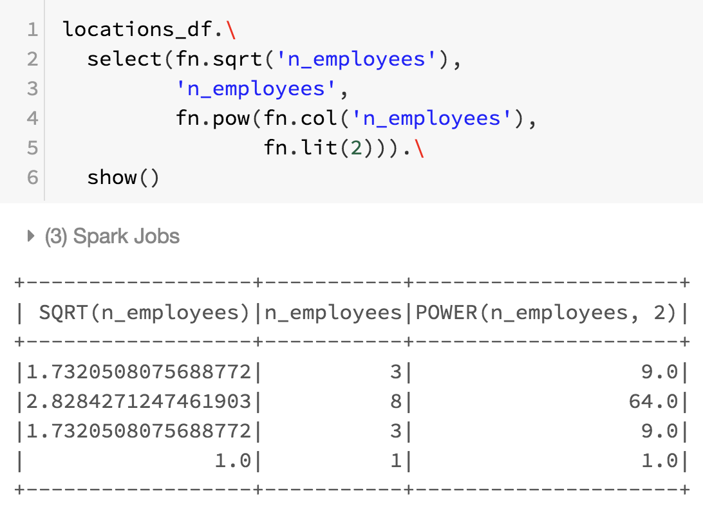
Selecting and modifying (2)
The following code snippet shows that new columns are created using utility functions provided by the Spark SQL utility function (fn) module.
Note that fn.lit() is needed to create a literal passed to pow

Slide 47
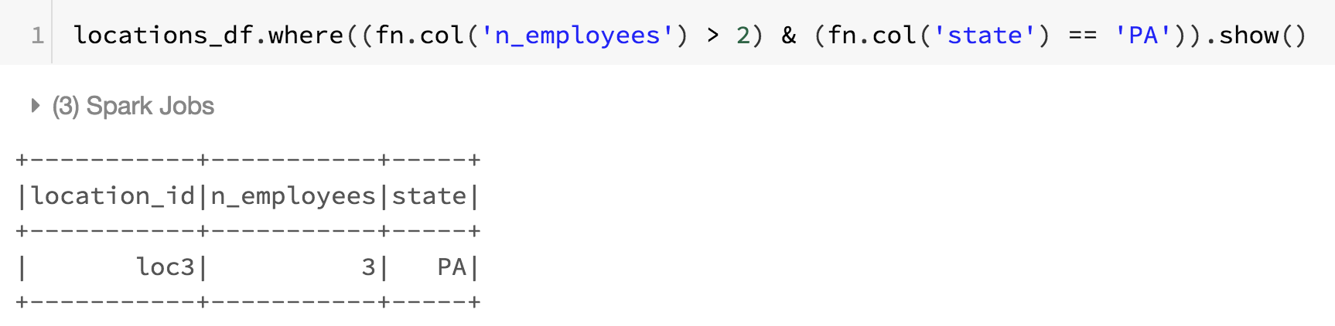
Filtering
where(expression): select only rows where expression is true
Expressions can be complex:

Slide 48
Joining
Inner joins (keep rows with keys that exist in the left and right datasets)
Outer joins (keep rows with keys in either the left or right datasets)
Left outer joins (keep rows with keys in the left dataset)
Right outer joins (keep rows with keys in the right dataset)
Left semi joins (keep the rows in the left, and only the left, dataset where the key appears in the right dataset)
Left anti joins (keep the rows in the left, and only the left, dataset where they do not appear in the right dataset)
Natural joins (perform a join by implicitly matching the columns between the two datasets with the same names)
Cross (or Cartesian) joins (match every row in the left dataset with every row in the right dataset)

Slide 49
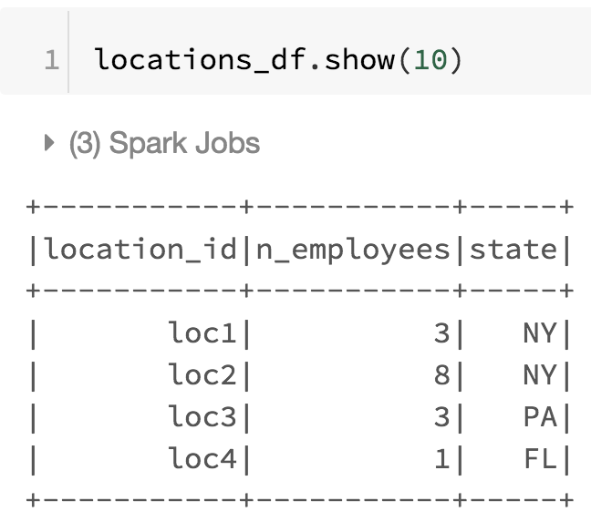
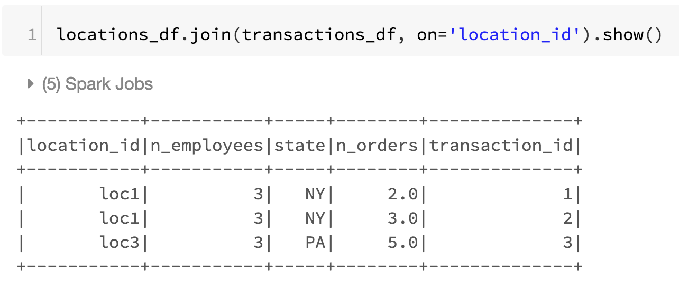
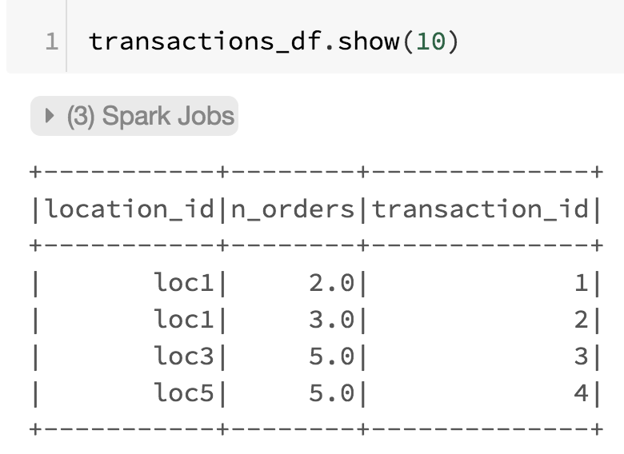
Inner Join
Keep rows with keys that exist in left and right data frames

Slide 50
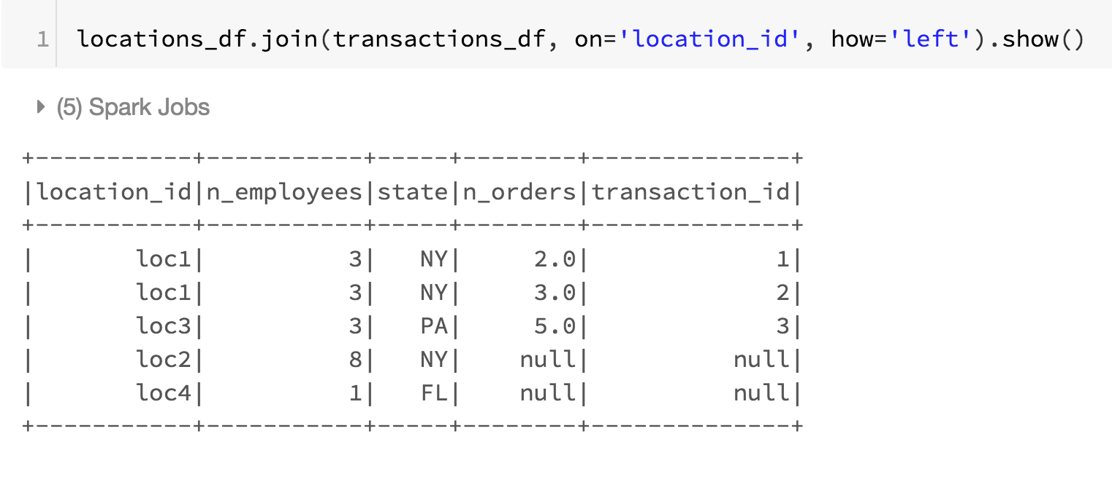
Left outer join
Keep rows with keys that exist in left data frame

Slide 51
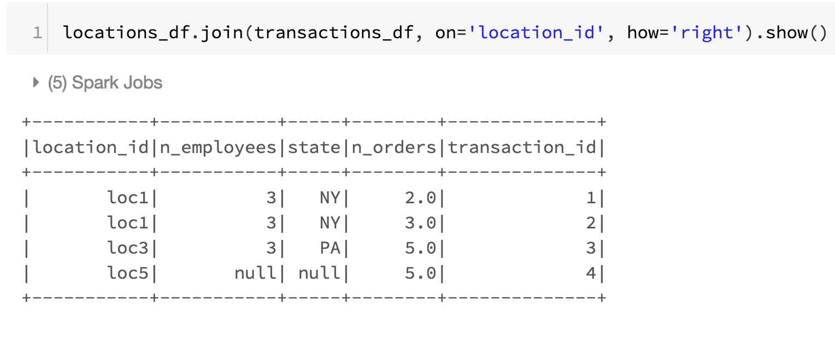
Right outer join
Keep rows with keys that exist in right data frame

Slide 52
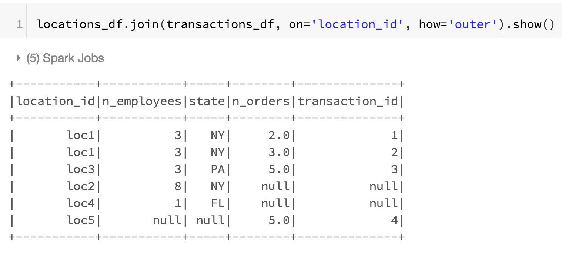
Outer join
Keep rows with keys that exist in either the left or right data frames

Slide 53
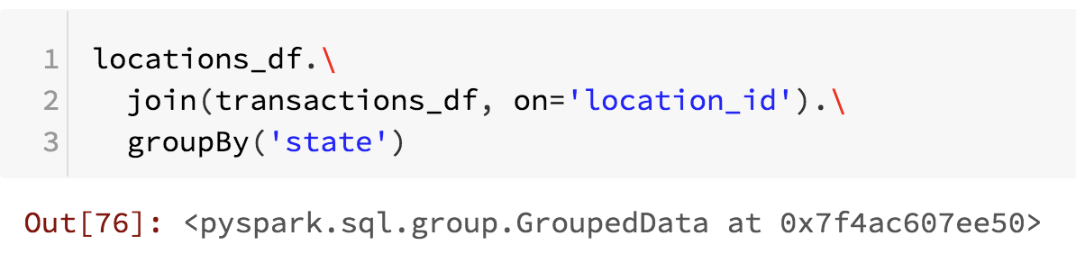
Grouping
groupBy(*expressions): groups by a list of expressions
Typically, a list of columns:
Note that this transformation does not do anything until we perform an action on the group object like an aggregate action.

Slide 54
Aggregate
There are some special functions that only work on grouped data
They are applied using the method agg(*expressions)
For example:
fn.sum, fn.stddev: self explanatory
fn.count: counts when column is not null
fn.countDistinct: how many distinct values of a column

Slide 55
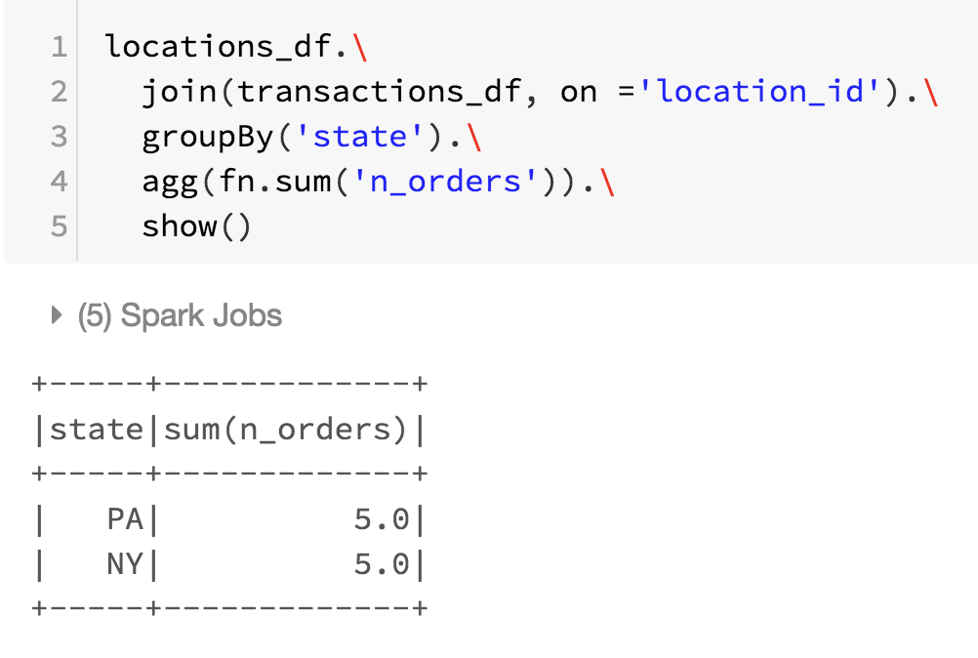
Aggregate

Slide 56
End of examples

Slide 57
Spark ML
Spark ML implements several machine learning algorithms at scale:
Regression
Classification
Decision Trees
Clustering
Deep Learning
It works on Spark DataFrames by performing transformations of the data
A typical data science analysis requires several transformations
These transformations can be implemented through Pipelines

Slide 58
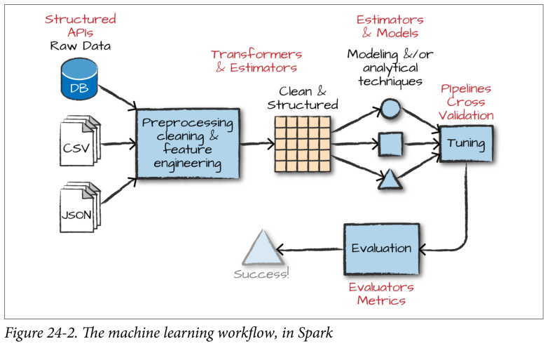
Example Spark machine learning workflow

Slide 59
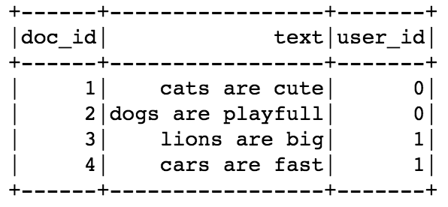
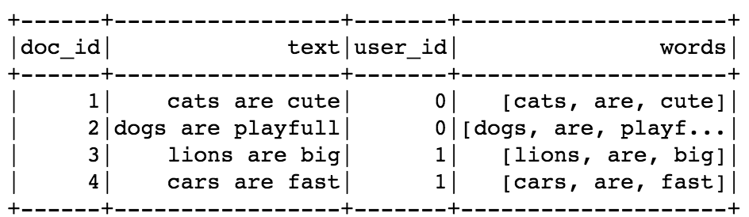
Spark ML: Transformers and Estimators
Note that Spark ML for RDD is deprecated
Preferred method for Spark ML is to work only with DataFrames.
Spark Machine Learning works by creating transformers and estimators using DataFrames as inputs
text
Tokenizer
(transformer)
words

Slide 60
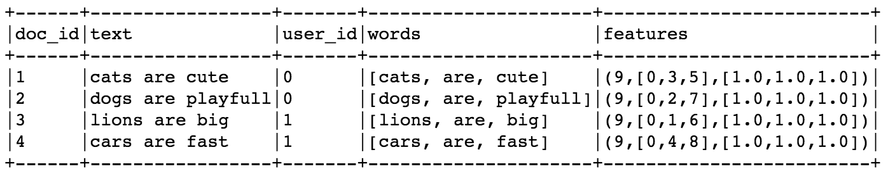
Spark ML: Transformers and Estimators
Transformers: An algorithm which converts one data frame into another data frame
Estimators: An algorithm which can be fit on a data frame to produce a transformer
For example, if we want to count terms in text, we need to know how many terms are in all documents
words
CounterVectorizer
(estimator)
CounterVectorizer
(transformer)
vocabulary
words
CounterVectorizer
(transformer)
features

Slide 61
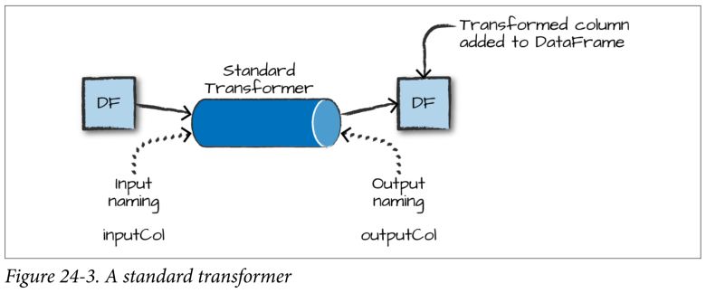
Example Spark Transformer

Slide 62
Spark ML: Pipelines
Data science is all about building data analytic pipelines from raw data to models
Spark ML Pipeline chains multiple Transformers and Estimators
Pipelines can be saved and shared
A Pipeline always starts as an Estimator that needs to be fitted
Pipeline (estimator)
Pipeline (transformer)
text
Tokenizer
CounterVectorizer
Tokenizer
CounterVectorizer

Slide 63
Spark ML: Pipelines
A Pipeline always needs to be fitted even when stages are all transformers
A Pipeline transformer contains an entire process
Pipeline (transformer)
words, features
text
Tokenizer
CounterVectorizer

Slide 64
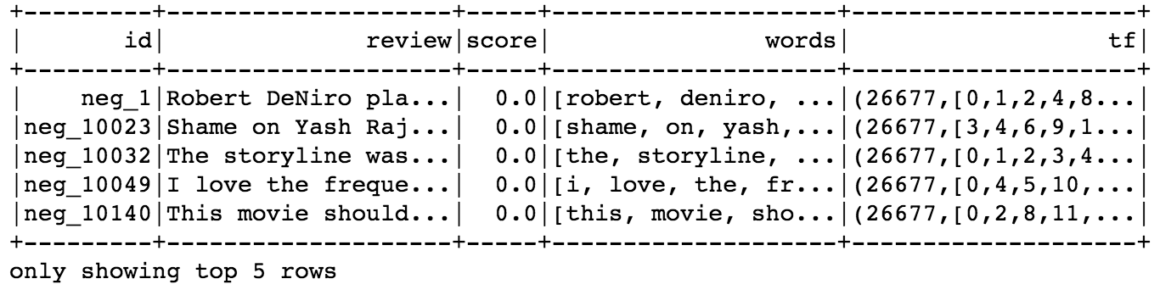
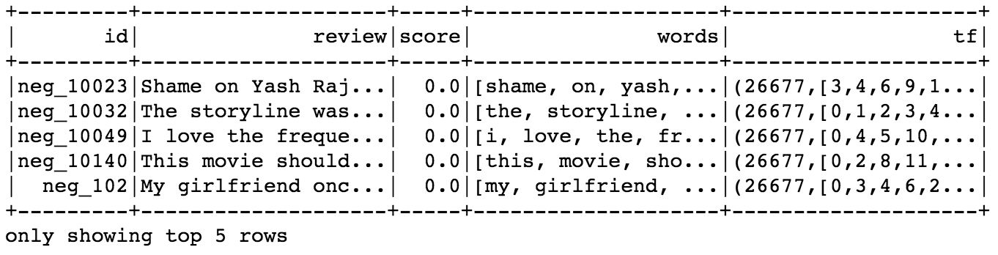
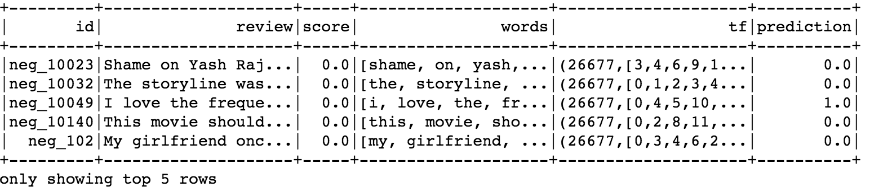
Spark ML: Algorithms
Some Estimators are algorithms that work on DataFrames
In this context, an algorithm is a machine learning model
For example, LogisticRegression
Training data
tf (X)
LogisticRegression
(estimator)
LogisticRegression
(transformer)
score (y)
Testing data
tf (X)
LogisticRegression
(transformer)
prediction

Slide 65
Spark ML: Algorithms
Algorithms can be part of Pipelines
Pipelines can be combined with other Pipelines
Pipeline (estimator)
Pipeline (transformer)
LogisticRegression
(estimator)
Tokenizer
CounterVectorizer

Slide 66
Evaluators
An evaluator allows us to see how a given model performs according to specified criteria
An evaluator is used to select the best model from a group of models.
An evaluator compares model predictions to truth data and calculates a score indicating how well the model performed.

Slide 67
Attendance
Please fill out the attendance sheet: https://docs.google.com/spreadsheets/d/1G5tiqXQn9mwyubWdINtPI_QONXH1_2U8oYikksgWlss/edit?usp=sharing
Write in a ‘1’ if you are present

